Slide 1

Impact of COVID-19: A Comparative Portfolio Analysis and a glimpse into the future
UofT FinTech - Group 3
Richard Yoo
Jessica Carmichael
Younwoo Choi
Manjari Shukla
Notes:
Richard

Slide 2



Summary
This project analyzes the Impact of COVID-19 on the stock market and portfolio earnings.
Core Message
To determine what is the best financial strategy to take when the next global crisis is apparent
Notes:
Richard
As the Global pandemic continues to create uncertainty, the aim of this project is to study:
1. The Impact of COVID-19 so far on the stock market and portfolio earnings.
2. What will happen in the next 10 years to the portfolio we decided on investing today

Slide 3


Objectives
What is the impact of COVID-19 on the stock market?
What is the effect of COVID-19 on the sectors represented in the custom portfolio?
How has COVID-19 affected the FinTech space?
What are the key takeaways from the analysis of portfolio stocks, Fintech ETF, and the overall market?
Notes:
Richard
A comparative analysis was done to study the impact of COVID-19 on a custom portfolio of 5 dividend paying stocks. This portfolio is compared with a Fintech ETF and, the S&P 500 Index is used as a benchmark for assessing trends in the stock market.
The reason why we chose to analyze these questions is because the next pandemic isn’t a matter of “If” it will happen but “when” will it happen. We are determining what is the best course of action to financially benefit from an unexpected disruptive event.

Slide 4
Data Used
Historical stock data from top 25 S&P 500 companies (Custom Portfolio was based on high dividend payments and sector diversification)
Microsoft (Technology Services)
JP Morgan Chase (Financial – Banking)
AT&T (Telecommunications)
ExxonMobil (Energy – Oil & Gas)
Pfizer (Healthcare)
S&P 500 performance; 2007 - 2020
COVID-19 Tracking Data and Statistics
API used for COVID-10 data for USA
GLB X FUNDS/FINTECH THEMATIC ETF(FINX)
Tabulate was used to Pretty-print tabular data in Python, a library and a command-line utility.
Notes:
Richard
This custom portfolio has been compared with the oldest and most established fintech ETF, as well as with the S&P 500 acting as a benchmark

Slide 5
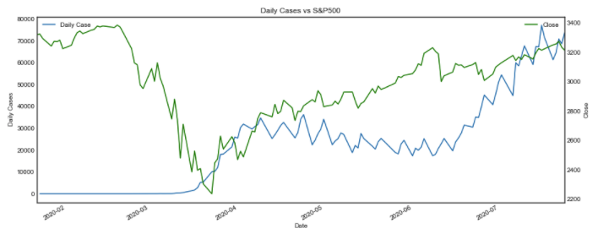
Data Cleaning & Exploration
Combine custom portfolio of daily returns
Combine custom portfolio with FINX ETF, and S&P 500 Returns
Investigate and plot data
Compare market performance with COVID-19 cases
Monte Carlo simulation for custom portfolio over 10 years
Challenges for data cleaning:
API data needed to be put into a JSON format
Data from 2007 – current is a massive amount of data to clean
Notes:
Richard
Our clean up process involved setting weights to the custom portfolio, calculating the daily returns then, combining and comparing the custom portfolio, FINX ETF, and S&P500 returns.
We conducted a Monte Carlo Simulation to determine possible future outcomes of investing in these assets. We then calculated the mean of the daily returns, the daily volatility, annualized STD, all to determine which portfolios are risker than the s&p500
An interesting thought to our investigation was that we anticipated that the stock market would be negatively correlated with the amount of COVID cases however we found that this was not true

Slide 6
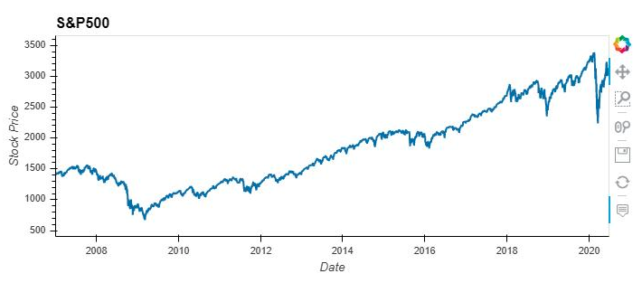


S&P 500 Performance
Q1. What is the impact of COVID19 on the stock market?
2007 - 2020
Feb 19th - $3,386
S&P 500 will be used as a benchmark for assessing trends in the market
The S&P 500 closed Q2 2020 up 19.95% accounting for its best quarter since Q4 1998 when the index gained 20.87%.
March 20th - $2,480
Notes:
Jessica
Policy actions across the globe, both in terms of monetary and fiscal stimulus packages, have cushioned the economic damage. The S&P 500 has gained strength based on a Federal Government stimulus package and the Federal Reserve rate cuts.

Slide 7
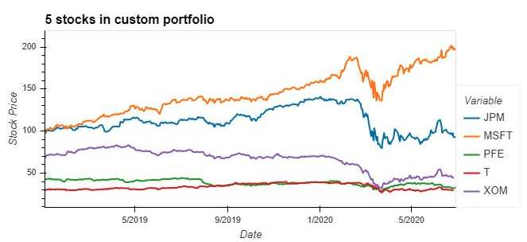
Custom Portfolio Performance
Q2. What is the effect of COVID19 on the sectors represented in the custom portfolio?
Tech, Healthcare, & Communication Services
Tech firms will need to evaluate impacts on supply chain, market demand and employees.
Healthcare service facilities were hit hard, however, healthcare stocks had a mild impact relative to other sectors
Integration of telecommunications was a critical component to workflow during this time
Notes:
Jessica
TECH (Microsoft) Orange – significantly affected and has fully recovered
The shift to working from home will continue to drive demand for infrastructure to support this shift. Tech companies are typically set up for remote work more than other industries and so will suffer less of a workplace culture shock.
HEALTHCARE (Pfizer [PFE]) Green – minimally affected and has recovered
As healthcare is focusing on emergency or COVID related services, there are significant less resources and demand for other healthcare needs. Pharma companies whose products are effective against COVID-19 will benefit financially.
COMMUNICATIONS SERVICES (AT&T [T]) Red – minimally affected and has recovered
The communications sector has remained “mission-critical” to keep economies moving under the lockdown in at least three different ways:
1. Providing business-critical connectivity;
2. Facilitating work-from-home arrangements;
3. Keeping individuals and societies connected and informed during mandated isolation

Slide 8
Custom Portfolio Performance
Financial & Energy Industries
Expected low or negative rates for several more years
May reduce profit and labor needed for banks
Reduced interest rates creates the potential for prolonged recession
Petroleum industry experienced a 40% drop due to decreased demand and a production dispute between Saudi Arabia and Russia
Notes:
Jessica
FINANCIAL INDUSTRY (JPM[JP Morgan]) Blue – Significantly affected and has not recovered
Central banks are expected to keep rates low for several more years, which has the potential to reduce profits and the labour needed to operate. The outcome of reduced interest rates, business activity, and large scale non-performing loans, has the potential to become a significant contributing factor to a prolonged recession. ‍
ENERGY (ExxonMobil [xom]) Purple –affected and starting to recover as demand returns
Saudi Arabia and Russia were not able to resolve the dispute of whether to cut back on oil production to match the decreasing demand of gas. Due to this lack of demand from travel restrictions, and without the decrease of production, the Oil and Gas industry was drastically impacted.

Slide 9
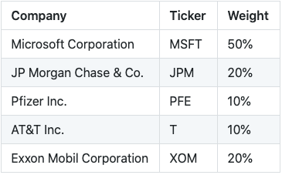
Custom Portfolio
Weights & Challenges
5 dividend paying stocks chosen from S&P 500 top 25 performing companies
Compare this portfolio with FinTech ETF
The 18-month timeframe has been chosen to represent pre COVID-19 to present time.
Challenges
Representation of industry
Past vs present performance.
Notes:
Jessica
Our choice of stocks in the custom portfolio was based on sector diversification and their performance
Two major challenges we experienced were:
One company will not accurately represent every company in that sector
Past performance may not be an accurate forecast for future performance.

Slide 10
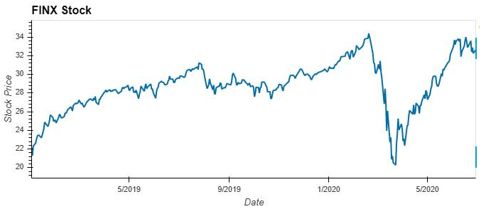
FinTech ETF
GLB X FUNDS/FINTECH THEMATIC ETF(FINX)
Oldest & most established FinTech ETF
47.33% appreciation between Jan 2019 – June 2020
Manage risk and lower costs
June 9 - $33.52
Feb 19 - $33.79
March 23 - $20.30
Notes:
Ethan
Many big fintech companies will be forced to utilize their technologies to create new opportunities to adapt to our current market. FinTech must be prepared not just to accommodate this increased demand but also to scale up their enterprise IT infrastructure while adapting to the new world, just like everyone else. ‍

Slide 11
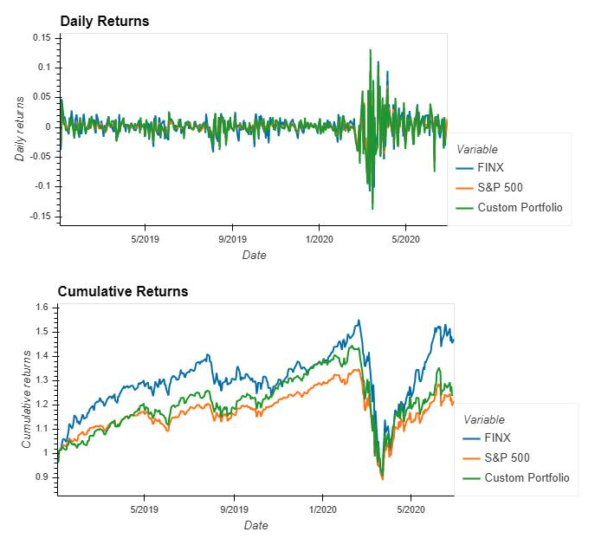
Comparative Analysis
The Custom Portfolio has the highest variations in returns
FINX and Custom portfolio outperformed the benchmark S&P 500.
Custom portfolio has more risk than FINX and S&P 500
Notes:
Ethan
Daily returns show higher variations in returns for the custom portfolio
Cumulative returns show that both FINX and the Custom portfolio outperformed the benchmark S&P 500.
Risk Analysis (STD rolling 21-day) showed that the custom portfolio has more risk than FINX and S&P 500

Slide 12
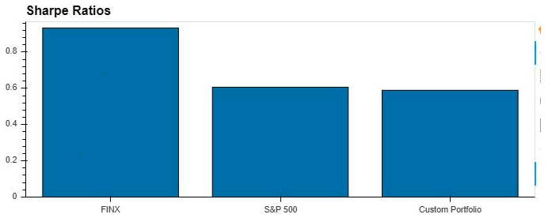
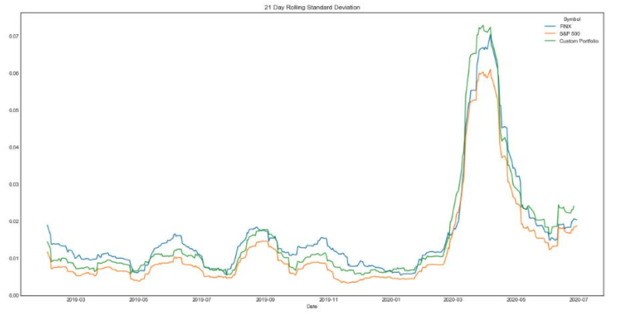
Risk Analysis
Sharpe Ratios & Rolling 21-day STD
Rolling 21-day STD :
FINX - 0.021597
S&P 500 - 0.017911
Custom Portfolio - 0.021822
Notes:
Ethan
The Sharpe ratios and the rolling 21-day standard deviation both show that the custom portfolio is riskier than FINX and the market.

Slide 13
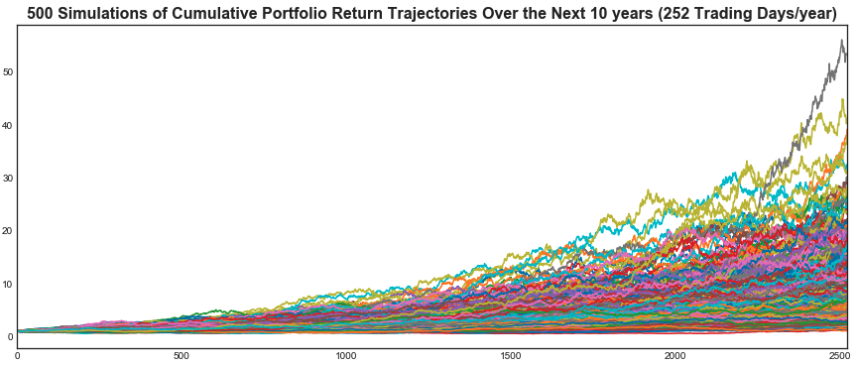
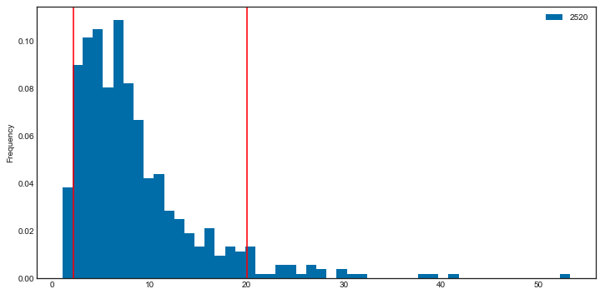
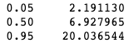
Custom Portfolio 10-year performance forecast
The higher a funds sharpe ratio, the better its returns have been relative to the amount of investment risk it has taken
FINX has the highest sharpe ratios and custom portfolio has the lowest sharpe ratios
Notes:
Ethan
Governments around the globe have already committed about $8 trillion to address the pandemic. This includes direct spending, equity injections, loans and guarantees. It is more than four times what all the countries on the planet collectively spent on military, weapons and war in 2019. It is 9.5% of pre-COVID global GDP.
We have simulated the performance of our custom portfolio for the next 10 years. The steps that we took to produce these results include; analyzing performance and risk to each portfolio, the rolling statistics for risk and beta, constructing a correlation table, a beta comparison for the custom portfolio and the FinTech ETF compared to the S&P500, calculating a rolling window for the EMA, annualized sharpe ratios, calculating volatility,
We performed Monte Carlo simulations on FINX ETF, S&P 500 and the custom portfolio for the next 10 years using historical data to perform a normally distributed random selection based on the sample mean and standard deviation of historical daily returns. Based on the simulations the returns for Custom Portfolio after 10 years at a 90% confidence interval would be in the range of 2.19% - 20.04%. The median being 6.93%.

Slide 14
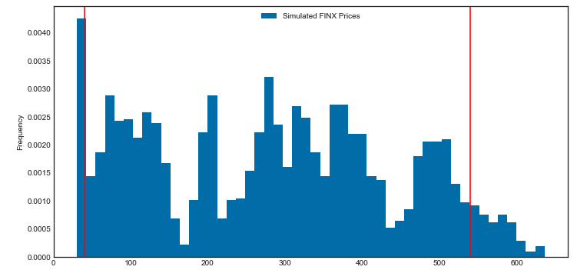
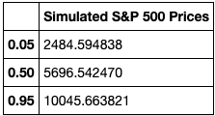
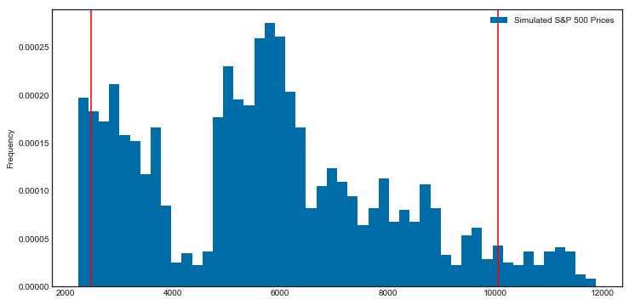
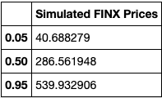
S&P 500 & FINX 10-year performance forecast
Notes:
Ethan
Based on the simulations the target price for FINX after 10 years at a 90% confidence interval would be in the range of $40.69 - $539.93. The median price being $286.56 giving a return of 718.98% from the current price of $34.99(July 28, 2020)
Based on the simulations, the target for S&P 500 after 10 years at a 90% confidence interval would be in the range of 2,484.59 - 10,045.66. The median being 5,696.54 giving a return of 77% from the current level of 3,218.44(July 28, 2020

Slide 15

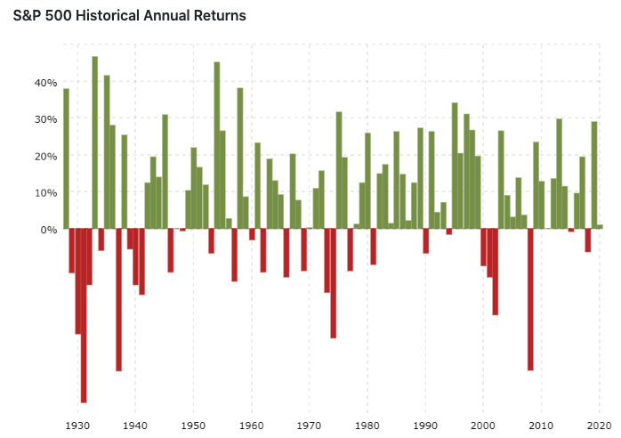
Actions to take before the next crash 1. Emergency Savings 2. SAVING FOR Expected Expenses 3. Investing to profit from the next crash Historical Market performance 1. MARKETs fall 10% from a recent high every 1-2 years 2. MARKETS fall 20% from a recent high every 5-7 years 3. stock MARKETS falling MORE than 20% has happened only 6 times
Q4. What are the key takeaways from the analysis of portfolio stocks, FinTech ETF, and the overall market now and ten years down the road?
Notes:
Manjari
Emergency Savings: In addition to having appropriate kinds of and amounts of insurance, we should aim to have cash savings that can cover six or more months of basic living expenses.
Expected expenses: While your emergency savings is preparing you for unexpected near-term needs, one should also prepare your portfolio for those expected needs. Investments away from stocks and into high-quality bonds. The goal is having a few years' expenses in these low-volatility assets before you need them.
Investing to profit from the next crash: Setting aside cash to invest in the next crash. A small portion of one’s portfolio say 5% of what would normally be investment in stocks can be held in cash to invest when the market drops quickly.
Investing half this cash when stocks fall 10% from a recent high, investing half of the remaining cash when stocks fall 20% and the rest at the 30% drop.
Stock market history shows that we see 10% declines about once every year or two, 20% declines about once every five to seven years; a 30% decline has happened only six times. Going by history, one can use this probability to take advantage of future downturns in the market.

Slide 16
Sources
https://www.spglobal.com/ratings/en/research/articles/200316-pharma-industry-only-moderately-affected-while-helping-mitigate-covid-19-pandemic-impact-11391384
https://www.accenture.com/ca-en/services/consulting/coronavirus-industry-impact
https://fintech-bulletin.com/the-impact-of-covid-19-on-different-fintech-sectors/
https://www.forbes.com/sites/chunkamui/2020/05/07/5-ways-our-coronavirus-recovery-strategies-might-make-or-break-the-future-part-1/#1f82c7c212b4
https://www.bbc.com/news/science-environment-52775386
https://www.fool.com/investing/2020/06/06/yes-another-stock-market-crash-is-coming-how-to-be.aspx
https://finance.yahoo.com/news/where-p-500-2030-heres-193118911.html
https://www.investopedia.com/articles/personal-finance/022216/put-10000-sp-500-etf-and-wait-20-years.asp
https://thefinancialbrand.com/96254/covid-19-impact-future-fintech-banking/
https://www.kaggle.com/gauravarena/canada-covid-19-impact-analysis
https://www.pwc.com/us/en/library/covid-19/coronavirus-technology-impact.html
https://www2.deloitte.com/global/en/pages/about-deloitte/articles/covid-19/understanding-covid-19-s-impact-on-the-technology-sector-.html
https://www.marketdataforecast.com/blog/impacts-of-covid19-on-information-technology-industry
https://www.investmentexecutive.com/news/research-and-markets/the-financial-industry-will-be-fundamentally-transformed-by-covid-19/
https://www.tcs.com/content/dam/tcs/pdf/Industries/Banking%20and%20Financial%20Services/COVID-19-Crisis-Implications-for-financial-services-industry.pdf
https://www2.deloitte.com/global/en/pages/about-deloitte/articles/covid-19/covid-19-s-impact-on-banking---capital-market-institutions-.html
https://www.cbinsights.com/research/fintech-covid-outlook/
https://www.kaggle.com/kittishane/covid-19-and-its-impact-on-business-in-each-sector
https://www.ifc.org/wps/wcm/connect/1d490aec-4d57-4cbf-82b3-d6842eecd9b2/IFC-Covid19 Telecommunications_final_web_2.pdf?MOD=AJPERES&CVID=n9nxogP https://www.fidelity.ca/fidca/en/products/fh https://globalnews.ca/news/6649509/coronavirus-gas-prices-canada/ https://www.marketwatch.com/investing/index/dwcogs/charts https://www.marketwatch.com/investing/stock/pfe/charts https://www.forbes.com/sites/jeffcamarda/2020/07/13/does-sp-500--us-economy--covid-stock-bubble/#180612385daa https://www.accenture.com/_acnmedia/PDF-126/Accenture-COVID-19-Communications-Media-Industry-Report-5.pdf https://www.patriotinvestment.com/blog/quarterly-market-commentary-first-quarter-2020
Notes:
Manjari

Slide 17
THANK YOU
Group 3
Richard Yoo
Jessica Carmichael
Younwoo Choi
Manjari Shukla
Notes:
Manjari

Slide 18
Questions?
Notes:
Manjari

